Slide 1
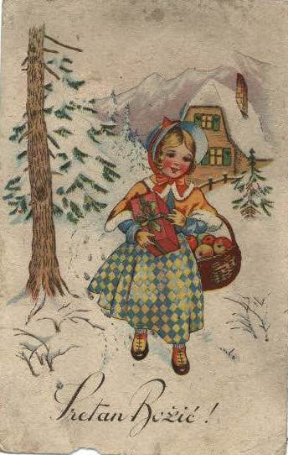
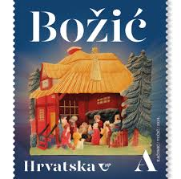
DIGITAL CHRISTMAS CARD EXCHANGE
CROATIAN CARD
Sretan Božić!
Na slici vidite staru hrvatsku božićnu čestitku. Stare božićne čestitke možete pronaći u digitalnoj arhivi Nacionalne i sveučilišne knjižnice u Zagrebu.
Osim božićnih, tamo možete pronaći i novogodišnje čestitke, kao i razglednice raznih mjesta diljem Hrvatske:
http://tradicijadobrihzelja.nsk.hr/
Merry Christmas!
In the picture you see an old Croatian Christmas card. You can find old Christmas cards in the digital archive of the National and University Library in Zagreb. In addition to Christmas cards, you can also find New Year's cards there, as well as postcards from various places throughout Croatia:
http://tradicijadobrihzelja.nsk.hr/

Slide 2
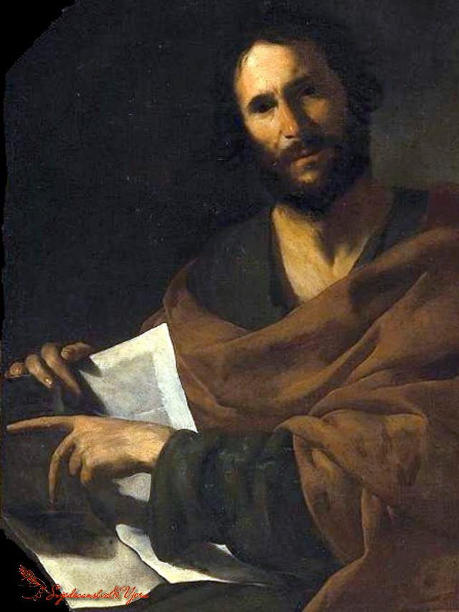
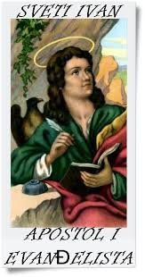
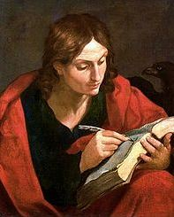
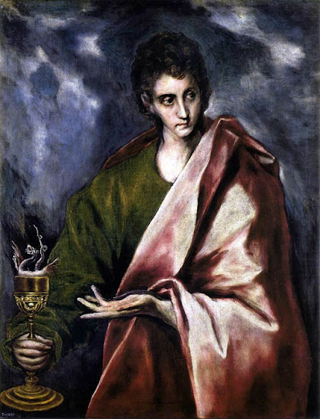
SRETAN BOŽIĆ!
Dan sv. Ivana
Na Dan sv. Ivana , 27. prosinca, u hrvatskoj se blagoslivlje vino u crkvi.
MERRY CHRISTMAS!
Day of St. Ivan
On the Day of St. St. John's Day, December 27, in Croatia, wine is blessed in the church.

Slide 3
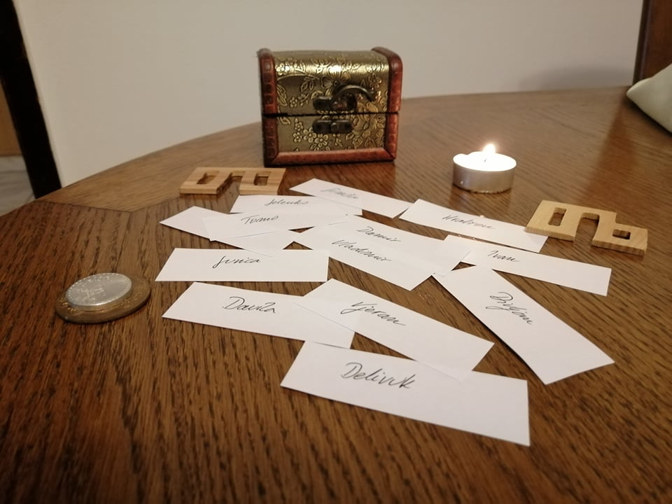
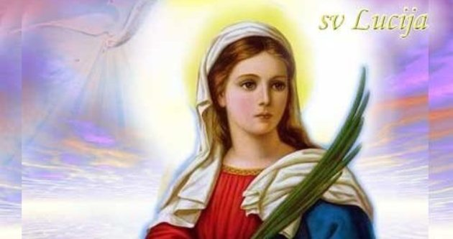
SRETAN BOŽIĆ! Trinaest papirića za sv. Luciju
Na dan Sv. Lucije neudane djevojke su ispisivale 13 ceduljica s imenom momka. Svakog se dana po jedan neotvoreni papirić baca u vatru, a djevojka će se udati za onoga čije ime posljednje ostane ispisano na cedulji.
MERRY CHRISTMAS! Thirteen pieces of paper for St. Lucia
On the day of St. Lucie's unmarried girls wrote 13 notes with the boy's name. Every day, one unopened piece of paper is thrown into the fire, and the girl will marry the one whose name remains written last on the piece of paper.

Slide 4
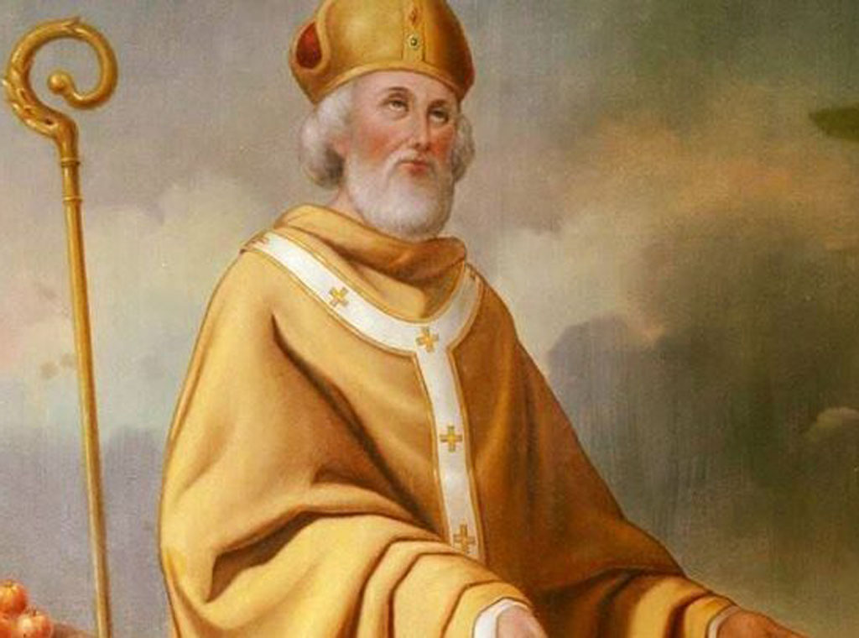
SRETAN BOŽIĆ !
Sveti Nikola U Hrvatskoj se slavi i dan sv. Nikole, 6. prosinca, kada se darivaju djeca. Djeca očiste svoje čizmice i stavljaju ih na prozor prije spavanja, a ujutro nalaze darove. Zločesta djeca dobivaju šibu. Običaji nisu isti u svim dijelovima Hrvatske.
MERRY CHRISTMAS!
Saint Nicholas
Croatia also celebrates the day of St. Nicholas, December 6, when children are given as gifts. Children clean their boots and put them on the window before going to bed, and in the morning they find presents. Naughty children get spanked. Customs are not the same in all parts of Croatia.

Slide 5
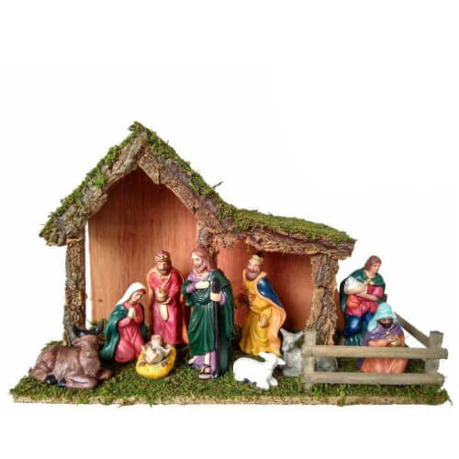
SRETAN BOŽIĆ! Jaslice ispod božićnog drvca Ispod drvca redovno su se stavljale jaslice, izrađene najčešće od drva. Ostaju do blagdana Bogojavljanja, a u crkvama do blagdana Krštenja Isusova. One su prikaz Isusova rođenja. Sastoje se od pomičnih ili nepomičnih figurica Djeteta Isusa, Djevice Marije, sv. Josipa te pejsažnih kulisa. Složenije jaslice imaju i mnoge druge likove poput pastira, anđela, svetih triju kraljeva i dr.
MERRY CHRISTMAS! Nativity scene under the Christmas tree Cribs, usually made of wood, were regularly placed under the tree. They remain until the Feast of the Epiphany, and in churches until the Feast of the Baptism of Jesus. They are a representation of the birth of Jesus. They consist of movable or stationary figurines of the Child Jesus, the Virgin Mary, St. Josip and landscape scenes. More complex nativity scenes also have many other characters, such as shepherds, angels, the holy three kings, etc.

Slide 6
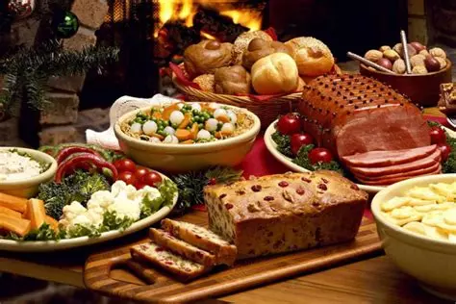
SRETAN BOŽIČ! Hrvatski božićni ručak Obitelji dan prije priprema bogati božićni jelovnik. Ručak je svečan i bogat te za stolom okuplja cijelu obitelj. Jede se: juha, meso - razne pečenke s povrćem, hladetina, sarma, pirjani kiseli kupus, kisela repu, krumpir, razne vrste kruha (božićna pogača, česnica, krsnica, božićnjak, križnica), peciva, voće i brojna druga jela. Od slastica jedu se: torte, orehnjače, makovnjače, kolači od oraha, rogača, sira, suhi sitni kolači, paprenjaci, smokvenjaci, medenjaci, muškaconi… MERRY CHRISTMAS! Croatian Christmas Lunch Families prepare a rich Christmas menu the day before. Lunch is festive and rich and brings the whole family together at the table. The food includes: soup, meat - various roasts with vegetables, cold cuts, sarma, stewed sauerkraut, sauerkraut, potatoes, various types of bread (Christmas pogača, česnica, krsnica, božićnjak, križnica), pastries, fruit and numerous other dishes. The desserts include: cakes, walnut cakes, poppy seeds, walnut cakes, carob cakes, cheese cakes, dry small cakes, pepper cakes, fig cakes, gingerbread, muškaconi...

Slide 7
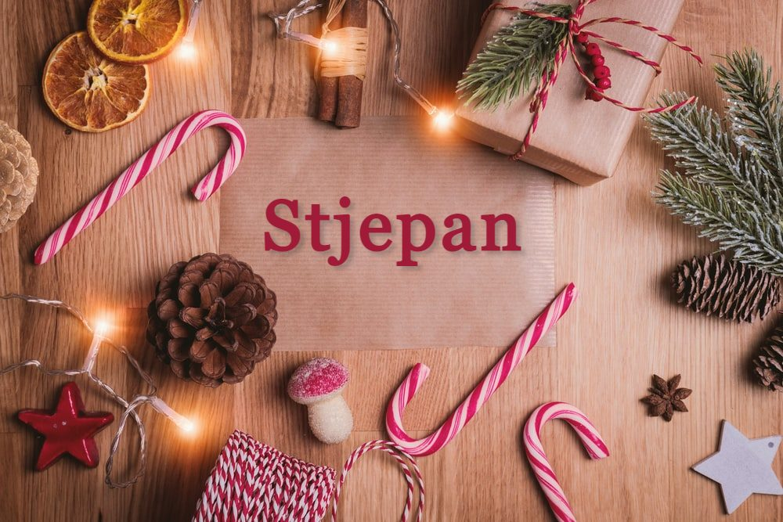
SRETAN BOŽIĆ!
Dan sv. Stjepana
Drugi dan Božića slavi se dan sv. Stjepana Prvomučenika (Štefanje, Stipanje). Tada se mnogi običaji ponavljaju kao i na prvi dan Božića. Ide se na sv. misu, posjećuju se rođaci, prijatelji, kumovi, susjedi. Slave se svetac zaštitnik i imendani.
SRETAN BOŽIĆ! Dan sv. Stjepana Drugi dan Božića slavi se dan sv. Stjepana Prvomučenika (Štefanje, Stipanje). Tada se mnogi običaji ponavljaju kao i na prvi dan Božića. Ide se na sv. misu, posjećuju se rođaci, prijatelji, kumovi, susjedi. Slave se svetac zaštitnik i imendani. MERRY CHRISTMAS! St. Stephen's Day The second day of Christmas is the day of St. Stephen the First Martyr (Štefanje, Stipanje). Many customs are repeated then, as on the first day of Christmas. People go to Holy Mass, visit relatives, friends, godparents, neighbors. The patron saint and name days are celebrated.
S

Slide 8
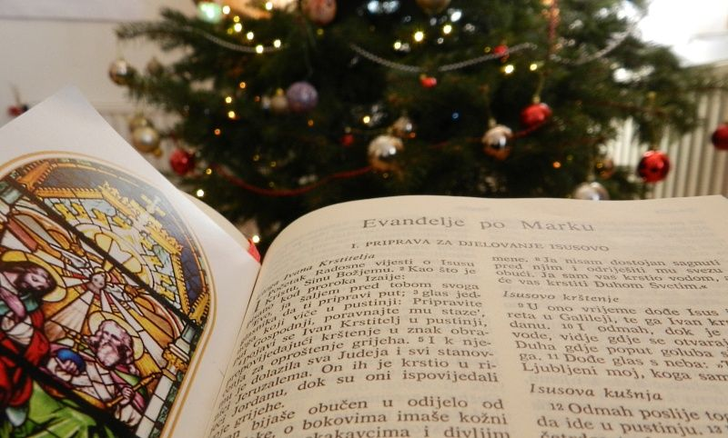
SRETAN BOŽIĆ! Blagoslov domova i obitelji-Na drugi dan Božića započinje blagoslov domova i obitelji. Obično traje do Bogojavljanja, ovisno o broju vjernika u župi. U manjim sredinama, može biti samo jedan dan.Na selu župnik svečano obilazi kućanstva u pratnji ministranata u bijelim haljinama i sakristana, koji ima kadionicu s tamjanom (jedan od darova Sveta tri kralja).
MERRY CHRISTMAS!
Blessing of homes and families -On the second day of Christmas, the blessing of homes and families begins. It usually lasts until Epiphany, depending on the number of believers in the parish. In smaller communities, it may only last one day. In the countryside, the parish priest solemnly visits households, accompanied by altar boys in white robes and a sacristan, who holds a censer with incense (one of the gifts of the Epiphany).

Slide 9
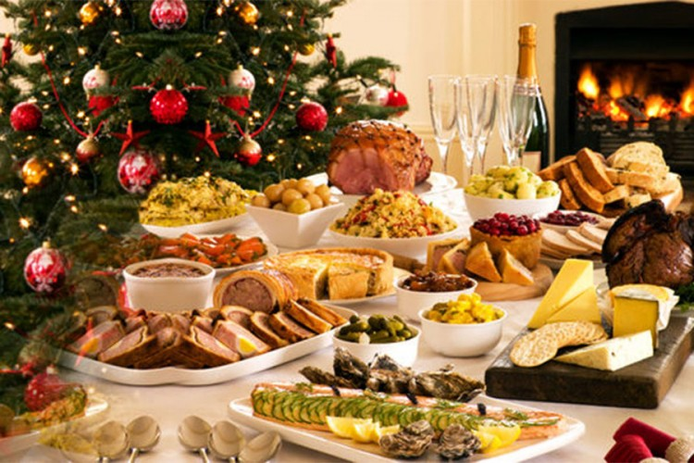
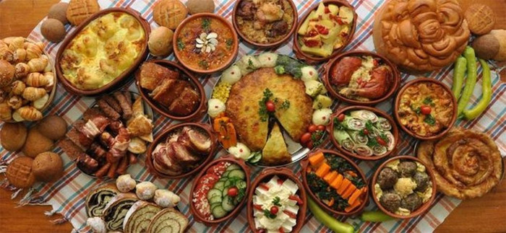
SRETAN BOŽIĆ!
Hrvatska božićni doručak-Na samo božićno jutro, ukućani jedni drugima čestitaju Božić. Za obilan i bogat doručak jede se pečenica s hrenom, hladetina, domaće kobasice, kulen, slanina, pršut sa sirom i maslinama.
MERRY CHRISTMAS!
Croatia Christmas Breakfast-On Christmas morning, family members wish each other a Merry Christmas. For a hearty and rich breakfast, they eat pechenica with horseradish, cold cuts, homemade sausages, kulen, bacon, prosciutto with cheese and olives.

Slide 10
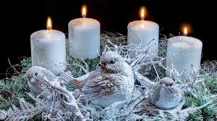
SRETAN BOŽIĆ!
Došašće ili Advent-Došašće ili advent vrijeme je priprave za Božić. Do 16. stoljeća, trajalo je 6 tjedana, a od tada traje 4 tjedna. Predvladavaju osjećaji iščekivanja, nade i čežnje.
MERRY CHRISTMAS!
Advent is the time of preparation for Christmas. Until the 16th century, it lasted 6 weeks, and since then it has lasted 4 weeks. Feelings of anticipation, hope, and longing prevail.

Slide 11
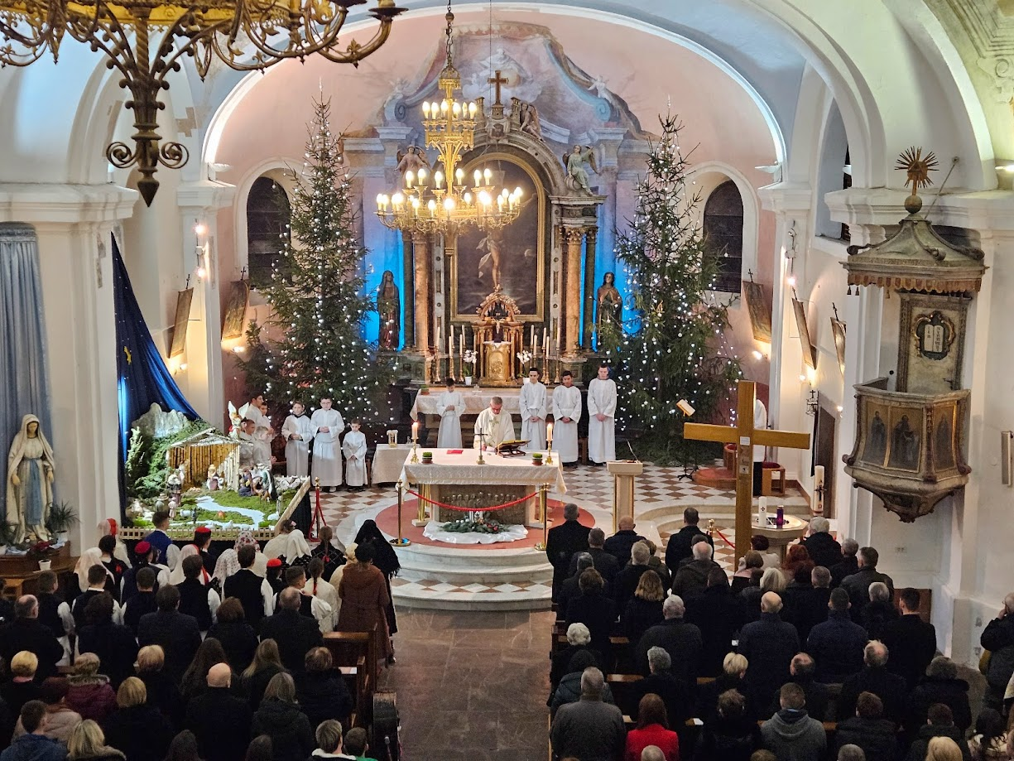
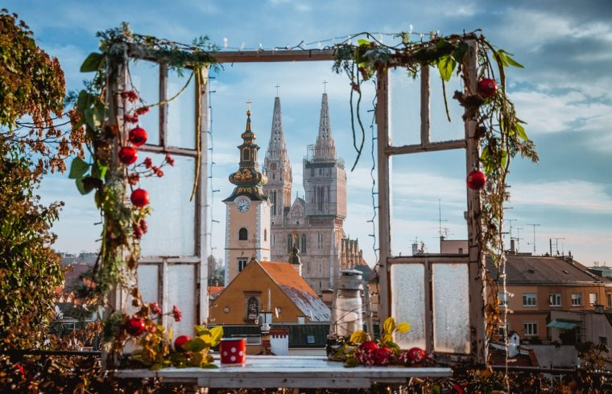
SRETAN BOŽIĆ!
Polnoćka-Poslije večere na Badnjak, još se malo sjedilo i razgovaralo, pjevalo ili molilo, a poslije se ljudi okupljaju na ulicama i odlaze na sv. misu polnoćku (ponoćka, ponoćnica ili polnoćnica). Pri tome se pjeva i ponegdje puca iz mužara i karabita.
Merry Christmas!
Midnight-After dinner on Christmas Eve, people would sit and talk, sing or pray for a while, and then people would gather in the streets and go to the midnight mass (midnight, midday or midday). At the same time, there is singing, and sometimes mortars and rifles are fired.

Slide 12
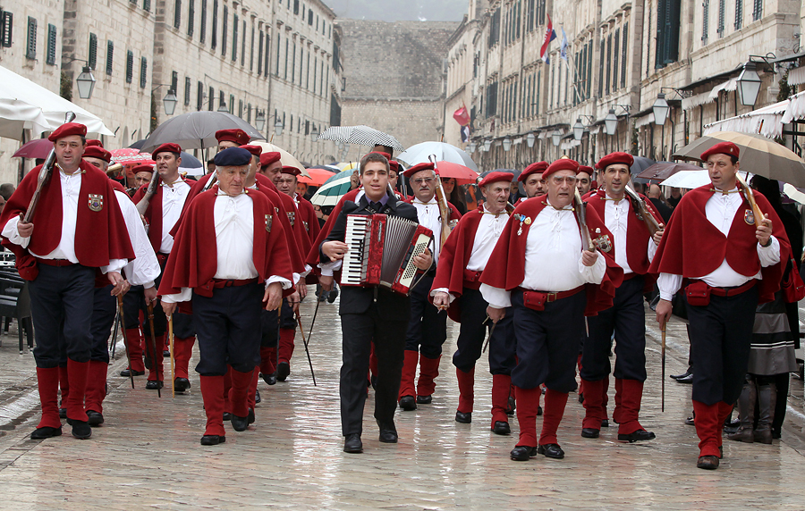
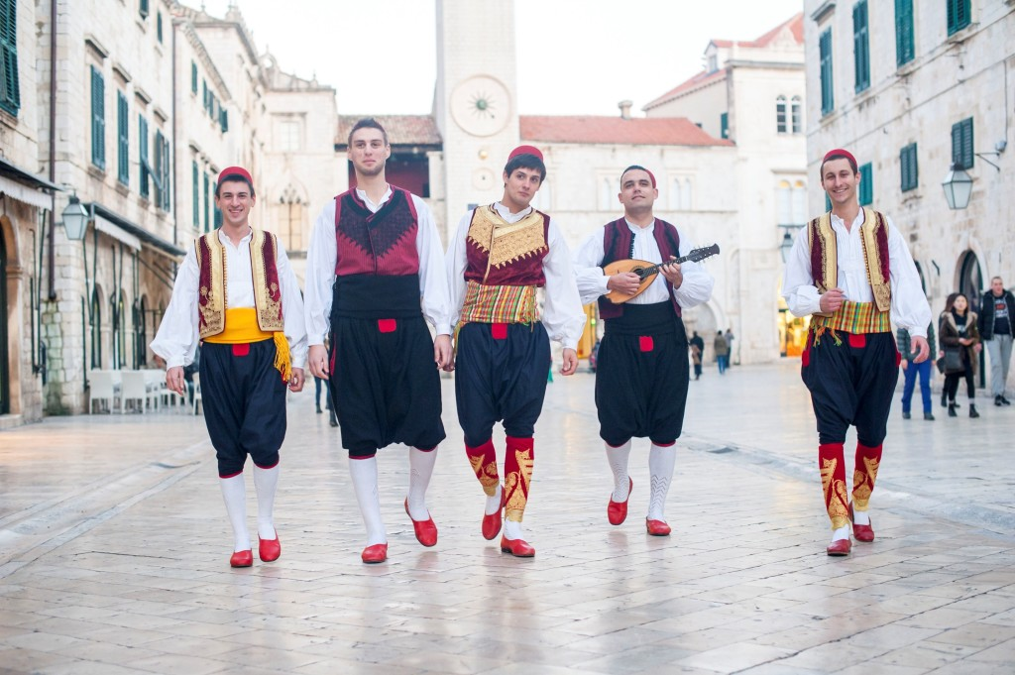
SRETAN BOŽIĆ!
Kolenda - Ponajviše na Jadranu postoji običaj koledanja. Grupe ophodnika idu po mjestu od kuće do kuće i čestitaju ukućanima Božić i Novu godinu uz prigodne božićne pjesme. Obično su muškarci različite dobi. Grupe kolendara obično su pjevale cijelu noć, a domaćini su ih častili suhim smokvama, narančama, rogačima, raznim slasticama, sokovima, vinom, rakijom a u novije vrijeme i novcem.
MERRY CHRISTMAS!
Carols -There is a custom of caroling, especially in the Adriatic. Groups of carolers go from house to house and wish their family a happy Christmas and New Year with appropriate Christmas songs. They are usually men of different ages. Groups of carolers usually sang all night, and the hosts treated them to dried figs, oranges, carobs, various sweets, juices, wine, brandy and, more recently, money.

Slide 13
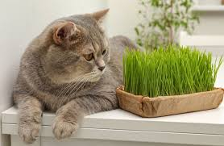
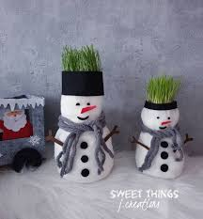
SRETAN BOŽIĆ!
Sijanje božićne pšenice
Sijanje božićne pšenice je lijepa tradicija koja simbolizira novi život i plodnost. Obično se sije uoči Svete Lucije, 13. prosinca, kako bi izrasla do Božića.
MERRY CHRISTMAS!
Sowing Christmas Wheat-Sowing Christmas wheat is a beautiful tradition that symbolizes new life and fertility. It is usually sown on the eve of Saint Lucy, December 13th, so that it will grow by Christmas.

Slide 14
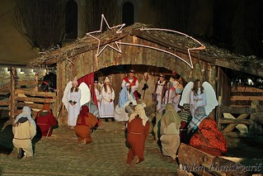
SRETAN BOŽIĆ!
Sveta tri kralja ili Bogojavljanje
Blagdansko razdoblje od dvanaest dana završava na Sveta tri kralja ili Bogojavljanje (6.siječnja). Ide se na misu i skidaju se ukrasi, blagoslivljaju se kuće i vrtovi te buduća ljetina
MERRY CHRISTMAS!
Epiphany-The twelve-day holiday period ends on Epiphany (January 6). People attend mass and take down decorations, and bless their homes and gardens, as well as the coming harvest.
.

Slide 15
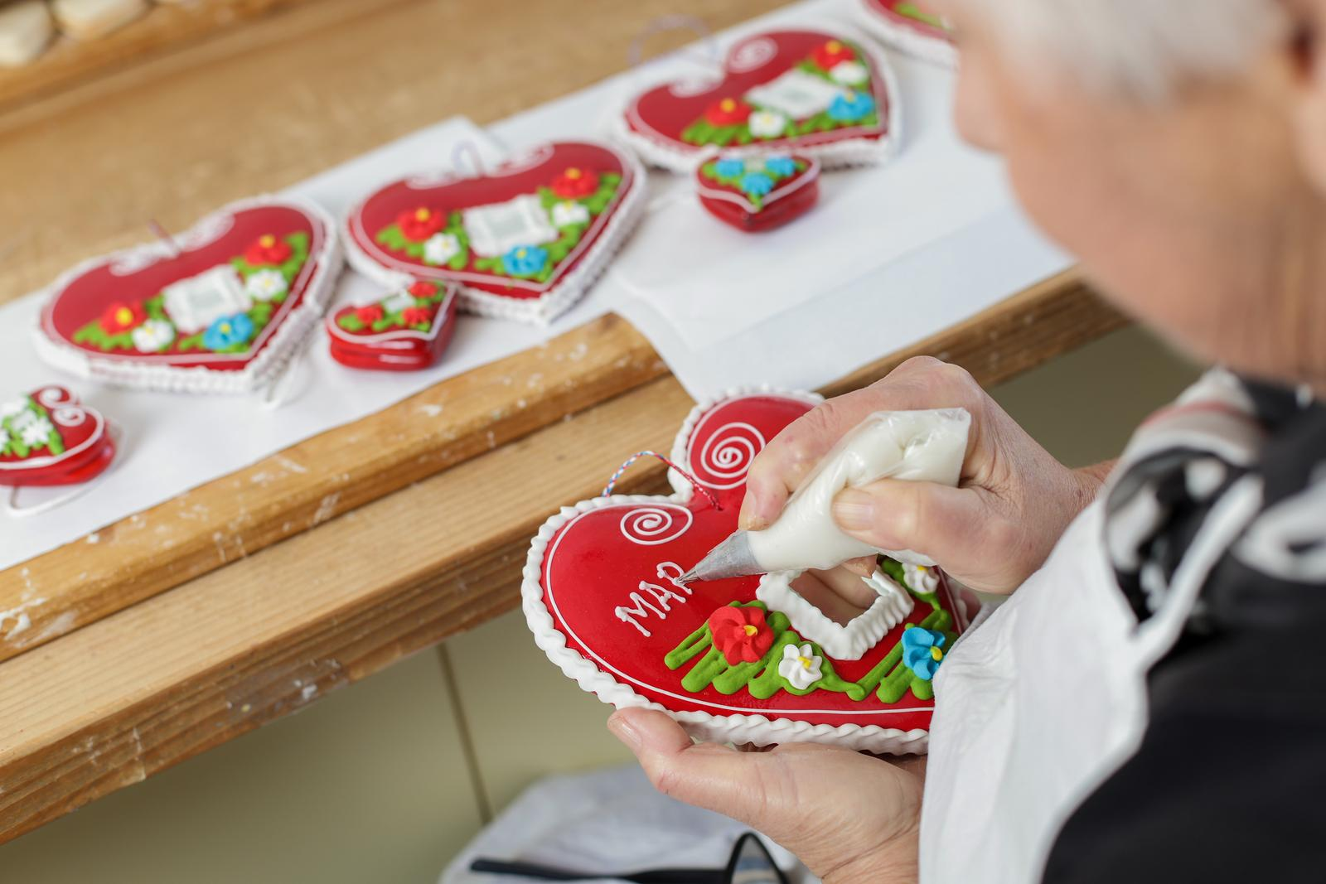
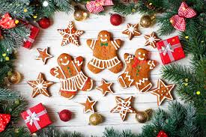
SRETAN BOŽIČ!
Božićni licitari-Licitar je šareno ukrašeni kolač od medenoga tijesta. Njegova se tajna izrade od davnine čuva u krugu obiteljskog obrta medičara središnje i nizinske Hrvatske. Iako je u cijelosti spravljen od jestivih sastojaka, ponajprije donosi radost očima i duši. Tradicionalno je žarko crvene boje, a proizvodi se u različitim oblicima i veličinama.
MERRY CHRISTMAS!
Christmas gingerbread cookies - Licitar is a colorfully decorated cake made from honey dough. The secret of its making has been kept since ancient times within the family craft of gingerbread makers in central and lowland Croatia. Although it is made entirely of edible ingredients, it primarily brings joy to the eyes and soul. It is traditionally bright red in color, and is produced in various shapes and sizes.

Slide 16
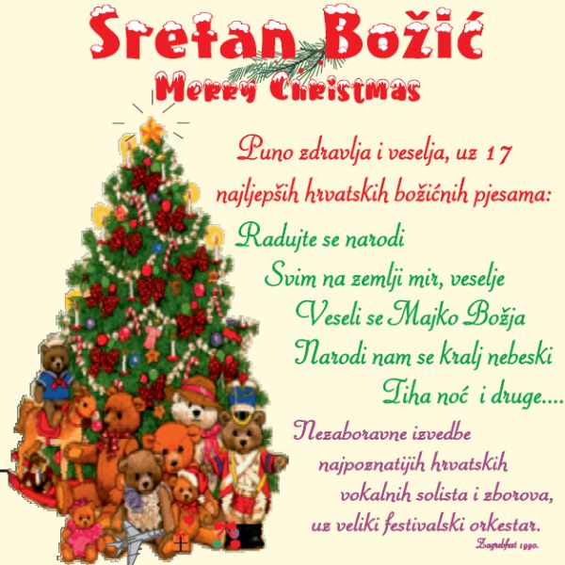
SRETAN BOŽIĆ!
Hrvatske božićne pjesme -Hrvatske božićne pjesme pripadaju među najbrojnije, najraznovrsnije i najljepše božićne pjesme na svijetu. Neke su vrlo stare, a neke su nastale prije 100 godina ili u novije vrijeme. "U SE VRIME GODIŠĆA (U TO VRIJEME
MERRY CHRISTMAS!
Croatian Christmas carols - Croatian Christmas carols are among the most numerous, diverse and beautiful Christmas carols in the world. Some are very old, and some were created 100 years ago or more recently. "AT THE TIME OF THE YEAR";https://www.youtube.com/watch?v=b2U9eyL3Do4
GODIŠTA)";https://www.youtube.com/watch?v=b2U9eyL3Do4

